Slide 1

BAH Cloud Engineering Presentation
Team 5
Just Right
Members: Ken Lopez Medina Dana Gibson Richard Ssebatta Jonathan Kaiser Kevin Mathew Romone Queen
September 2022

Slide 2
TEAM 5 Project Just Right
Our Official Project for the BAH Cloud Engineering Program
www.webagesolutions.com|1.877.517.6540

Slide 3
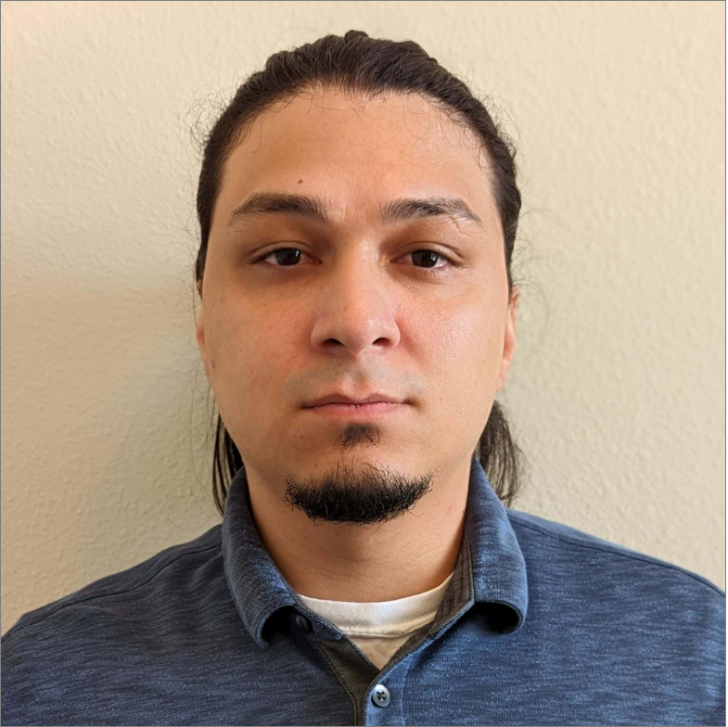
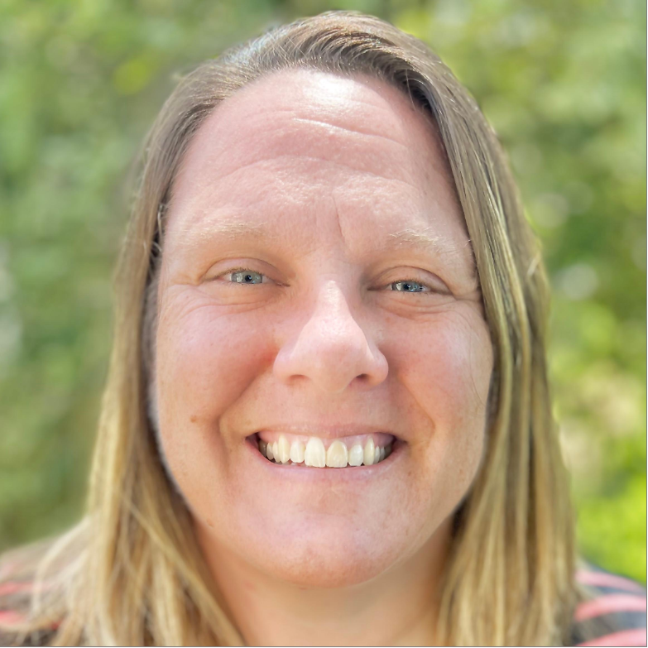
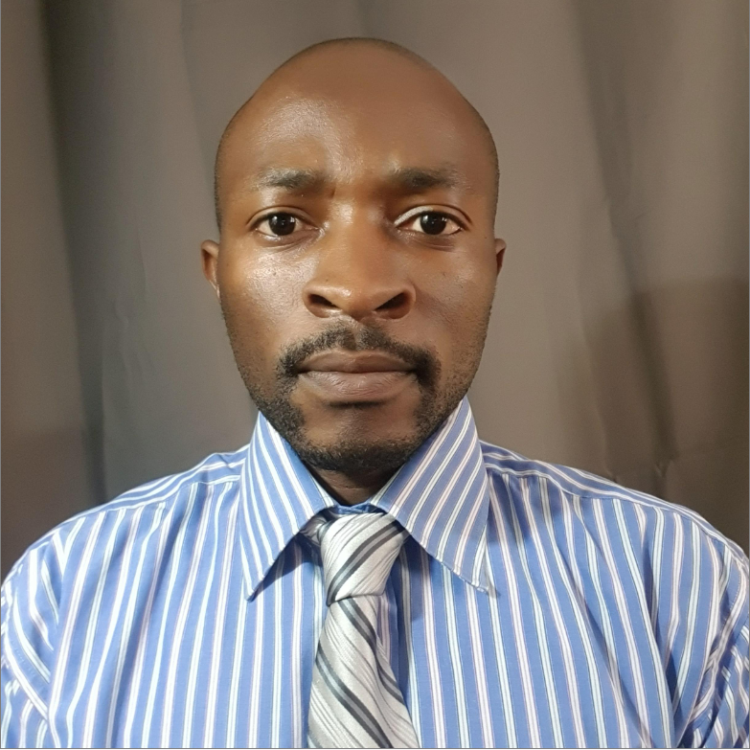
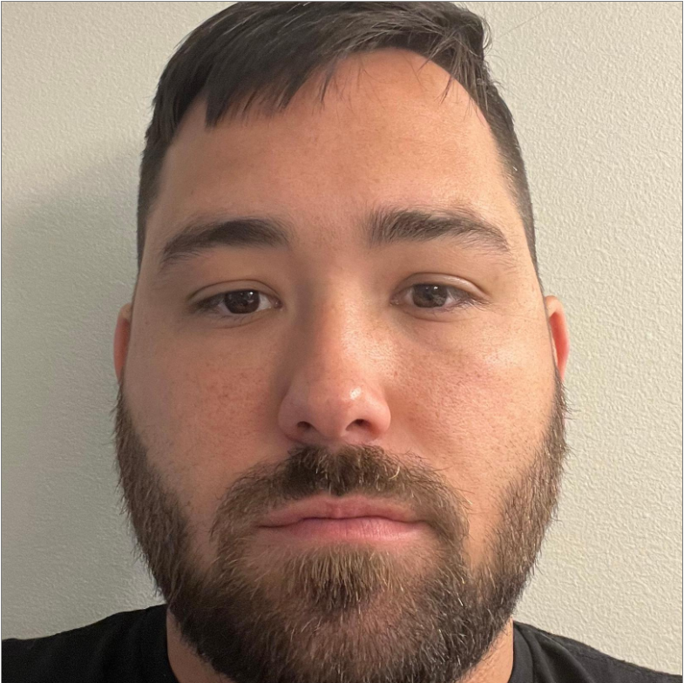

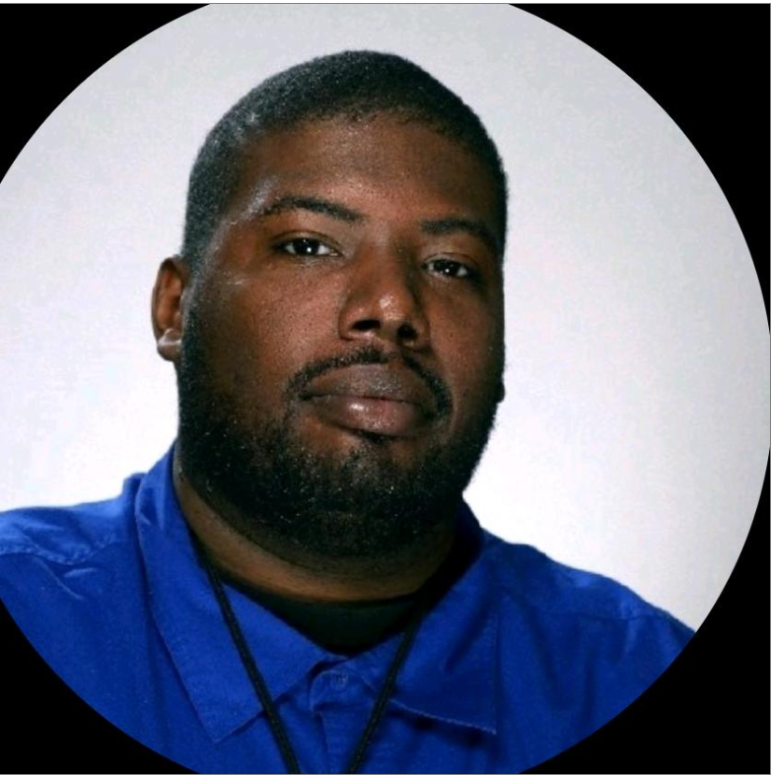
INTRODUCTIONS
Everyone
Ken Lopez Medina Staff Technologist
Dana Gibson Staff Technologist
Richard Ssebatta Technologist
Jonathan Kaiser Staff Engineer
Kevin Mathew Engineer
Romone Queen Lead Engineer

Slide 4
Project Just Right
Dana: Project Overview
Introductions
Project Overview
Tools/Software Environment used
Architecture/Design diagram
Challenges & Issues
Lambda Function
Demo
Website design
API/Triggers
Future plan and implementation ideas
Questions and answers
Serverless framework connecting Lambda, API and DynamoDB.
www.webagesolutions.com|1.877.517.6540

Slide 5
Dana
Technologies and Environment used
React
AWS S3
Amazon API Gateway
Amazon Lambda
Amazon DynamoDB
Visual Studio Code / AWS Cloud9
GitHub
Draw.io

Slide 6
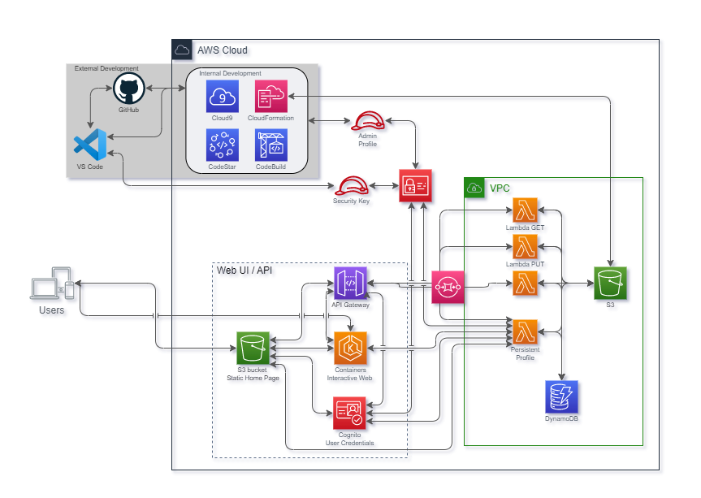
Ken
Architecture and Design
Where we started:

Slide 7
Ken
Architecture and Design
Where we ended:

Slide 8
Jonathan:
Challenges and Issues
Biggest Challenge: Thinking too big
Webserver:
- Authenicating Users - Thinking too big
- Communication between different AWS Services with the website.
Lambda:
- Combining multiple inputs from API to DynamoDB
- Communication between API, Lambda, and DynamoDB
Coding
- initially Python…moved to Java Script
Failed attempts
- Amplify
- EC2 instance
- Potentially infrastructure to show what we wanted

Slide 9
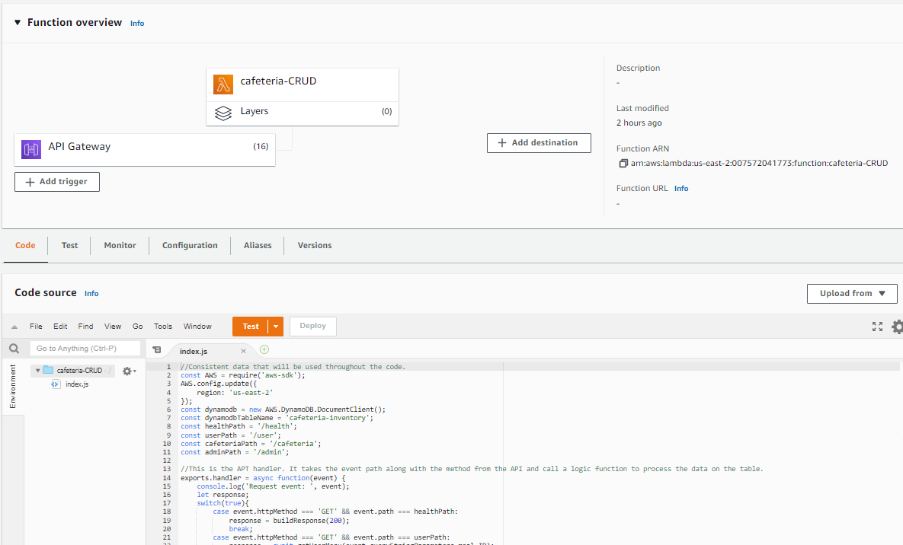
Lambda Functions
Romone:

Slide 10
Kevin
Demo

Slide 11
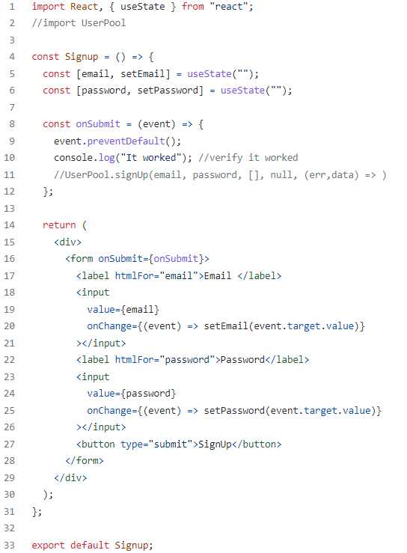
Kevin
Website/React

Slide 12
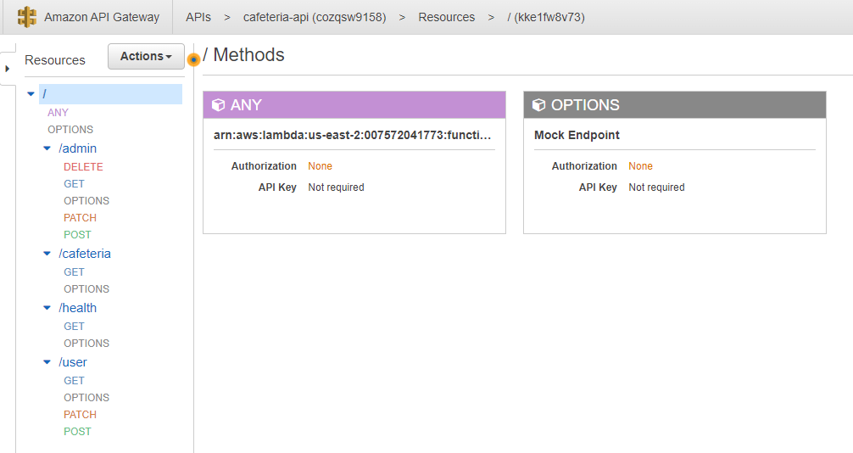
Richard:
API

Slide 13
Richard:
Future plans and implementation ideas

Slide 14
Q & A - Ask us anything

Slide 15
Thank you!!!
September 2022

